Slide 1
CSE 3120 Software Engineering and Information Systems Laboratory
Weather App

Slide 2
Weather App A java based application
Git collaboration: Efficient team collaboration using git.
Design pattern implementation: Implemented singleton, factory, adapter, observer.
Unit testing: Ensured component reliability with JUnit.
Integration testing: Validated module interactions.
UI testing: Verified UI correctness and responsiveness.(Failed)
CI/CD implementation: Automated build, test, and deployment.
Used API(Application Programming Interfaces) for fetching data to show in app.

Slide 3
Objective & key features
Daily Weather Update:
Receive real-time weather updates for the current day.
Display current temperature, humidity, wind speed, and weather conditions.
Update weather information periodically to reflect changes throughout the day.
7-Day Forecasting:
Access a 7-day forecast for the upcoming week.
Show daily high and low temperatures for each forecasted day.
Present weather conditions expected for each day, including precipitation, cloud cover, and wind direction.
Allow users to view detailed forecast information, such as hourly weather predictions and chance of precipitation.

Slide 4
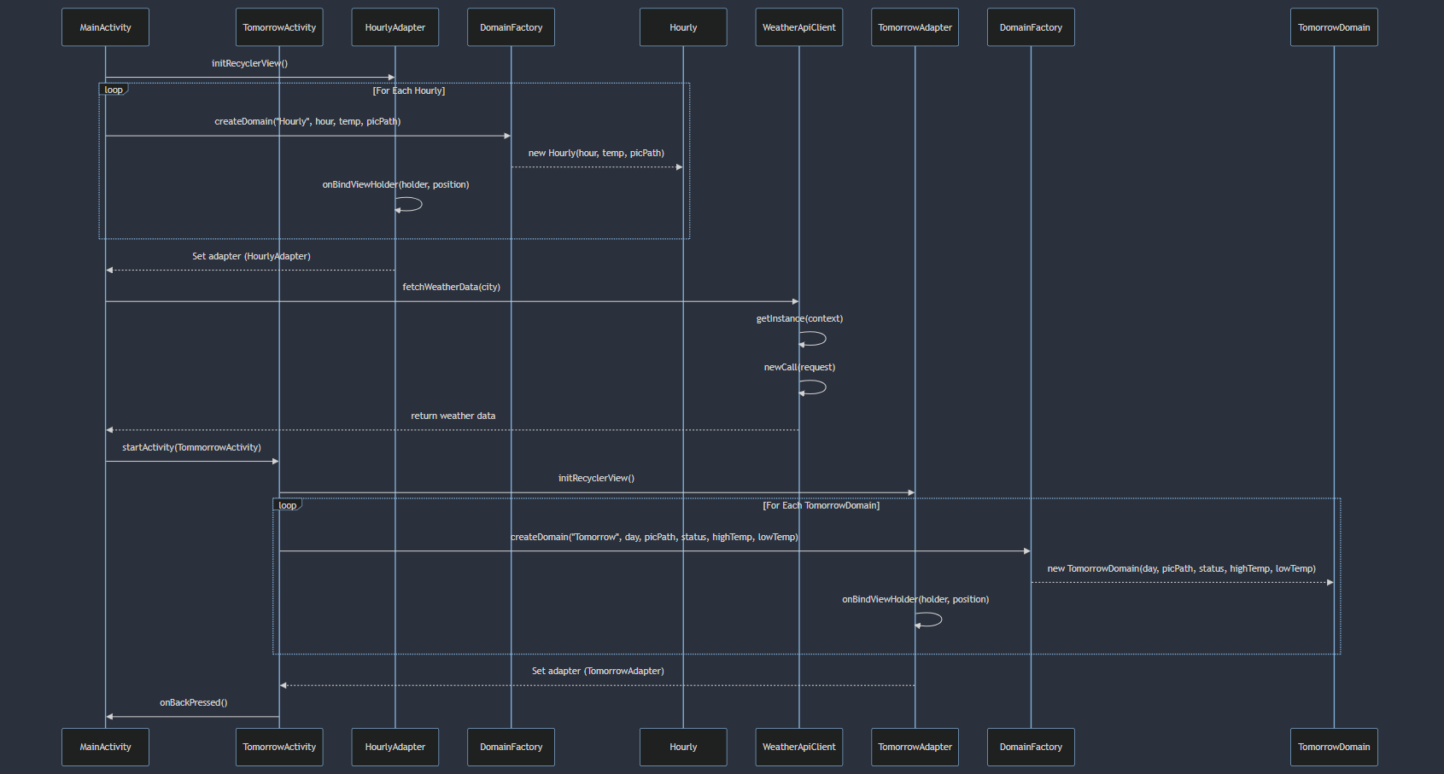
Sequence Diagram

Slide 5
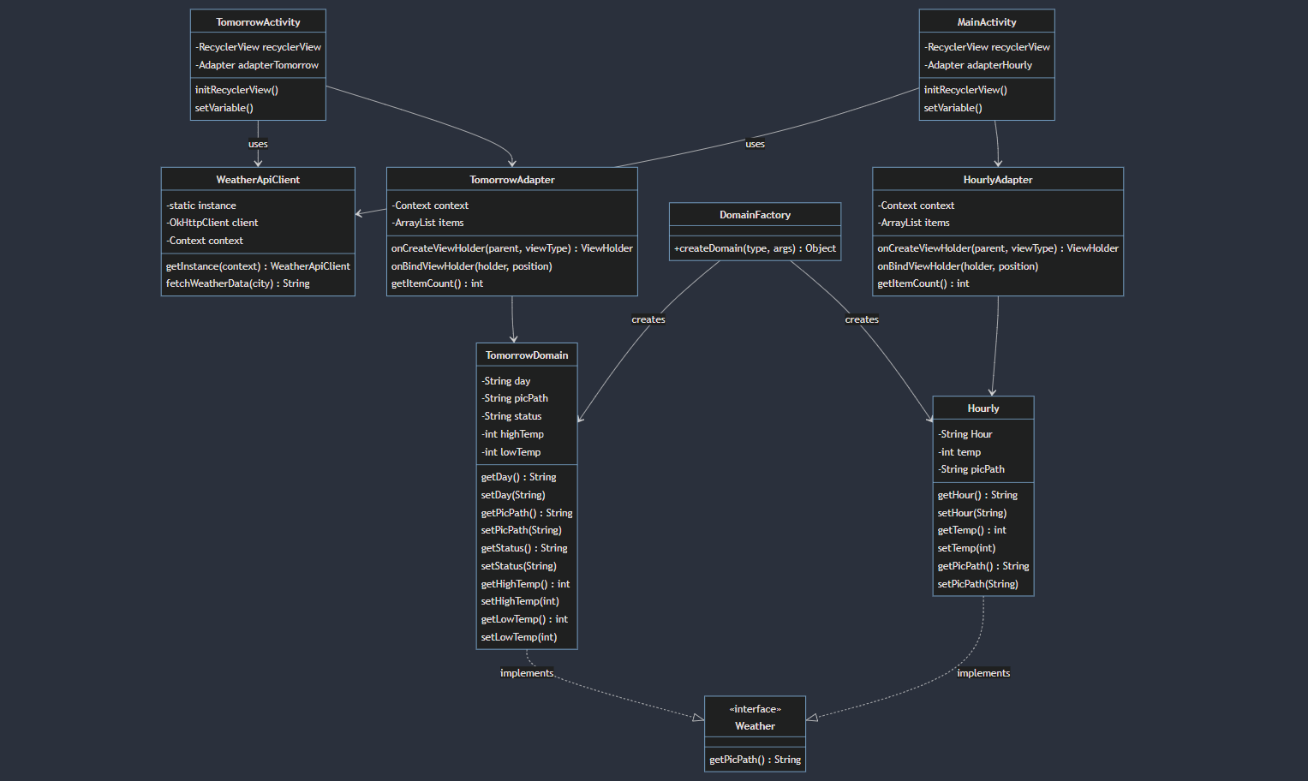
Class Diagram

Slide 6
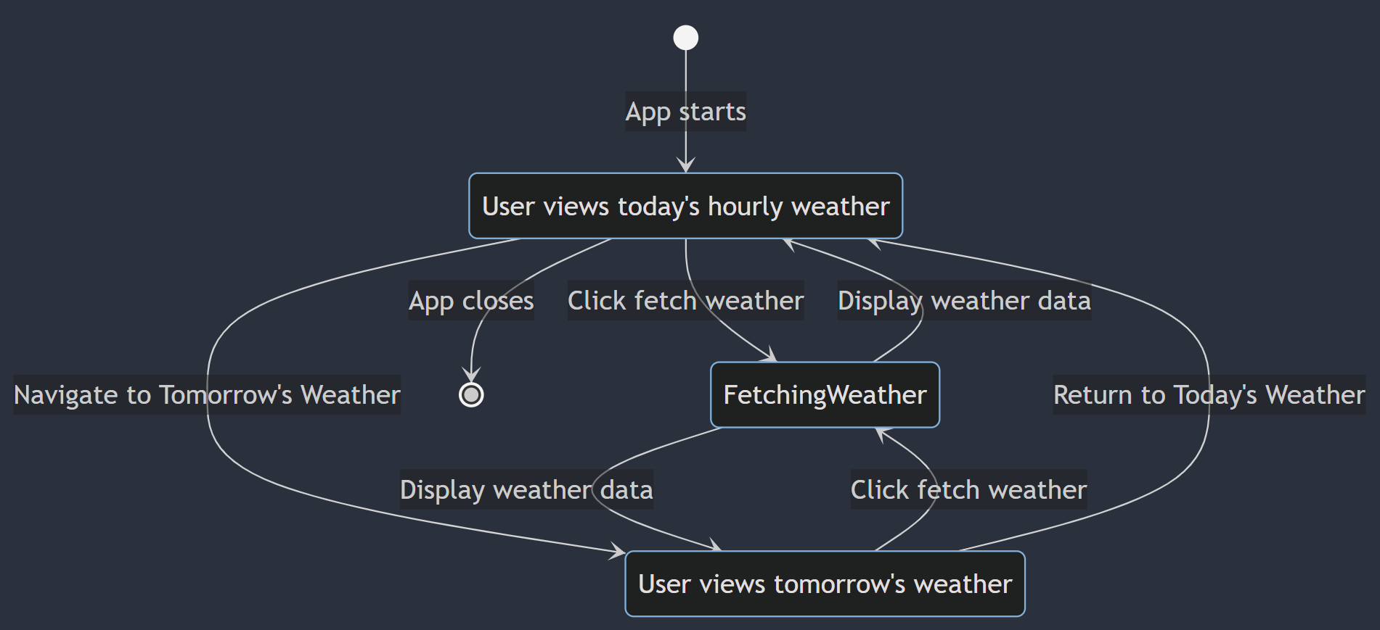
State Diagram

Slide 7
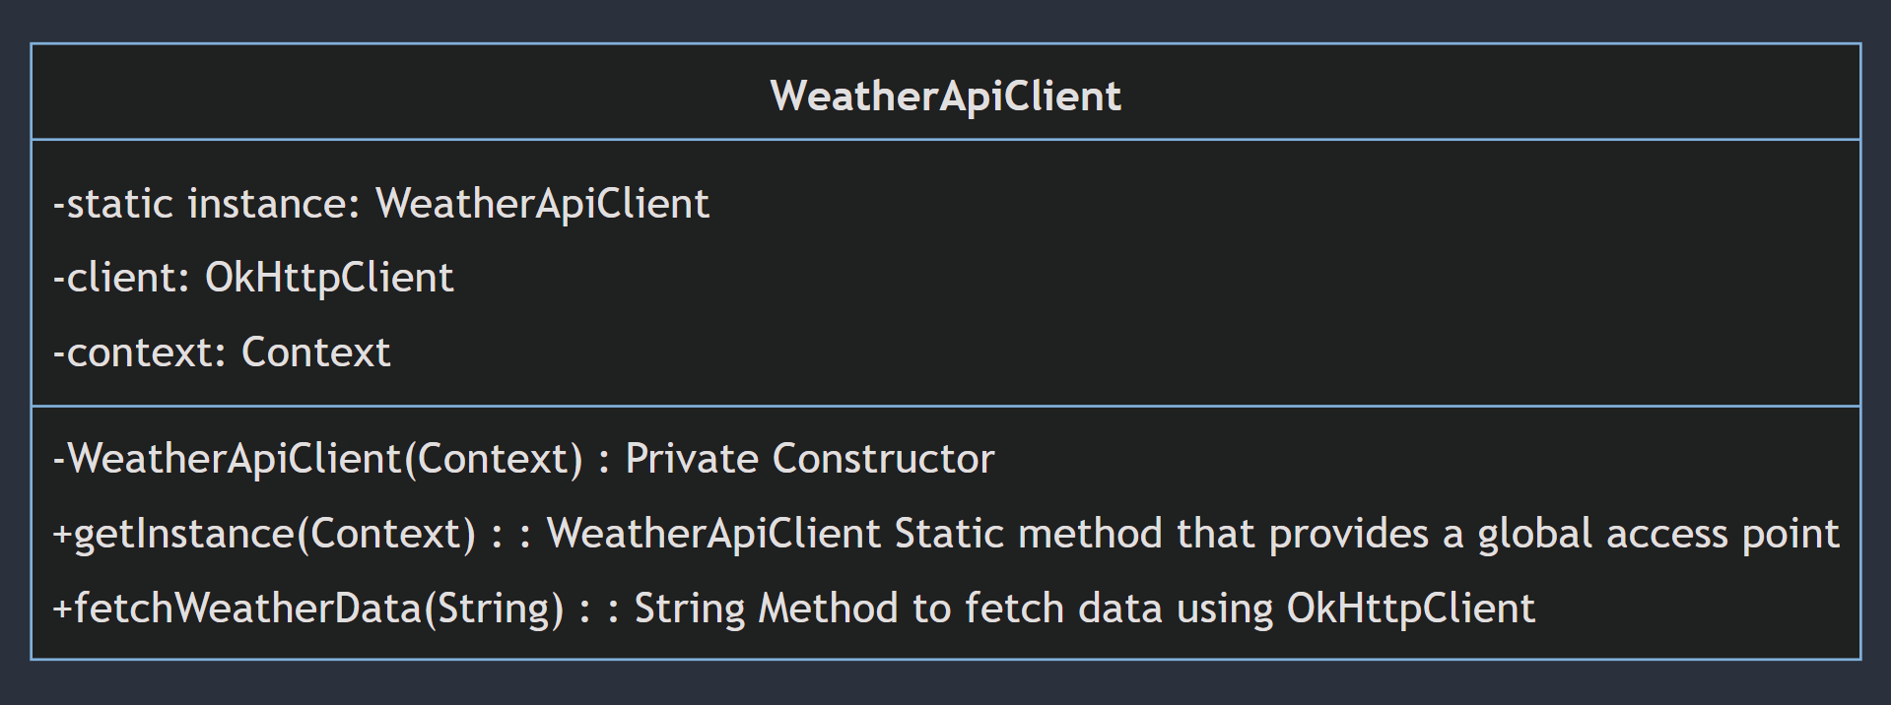
Design Pattern
Singleton Design Pattern:
The WeatherApiClient class uses the Singleton design pattern to ensure only one instance manages HTTP requests using OkHttpClient. It includes a private constructor, a static getInstance method to retrieve the single instance, and a fetchWeatherData method to obtain weather data for a given city.

Slide 8
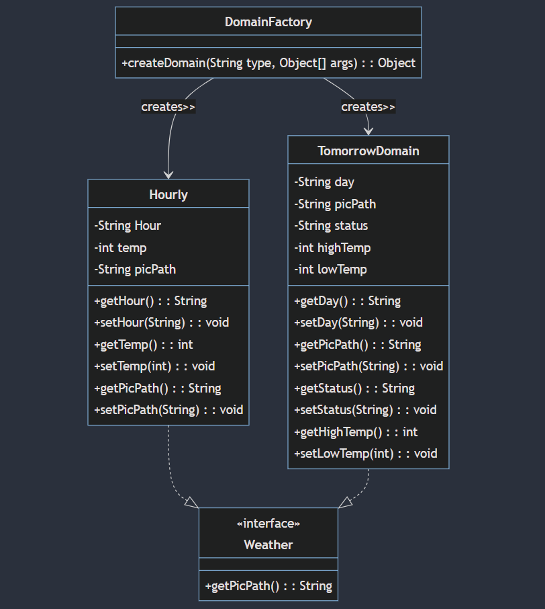
Design Pattern
Factory Design Pattern:
This diagram illustrates a class hierarchy for a weather app, where the DomainFactory class creates instances of Hourly and TomorrowDomain classes. Both Hourly and TomorrowDomain implement the Weather interface, ensuring they provide a getPicPath() method. Hourly and TomorrowDomain have various attributes and methods to manage weather data for specific times and days, respectively.

